Slide 1

January-October 2025
MINISTRY HIGHLIGHTS

Slide 2
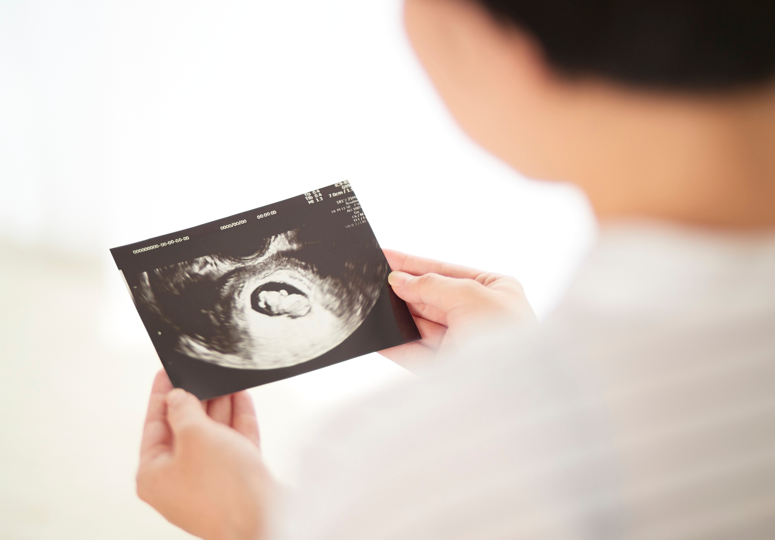
OUR CENTERS PERFORMED
1,610
LIFE-CHANGING ULTRASOUNDS
A 36% INCREASE

Slide 3

WE PRAYED WITH CLIENTS
4,294
TIMES
WITH THEIR PERMISSION

Slide 4

NEARLY
12,800
PEOPLE SERVED
ACROSS ALL OF OUR CENTERS
AND PROGRAMS

Slide 5
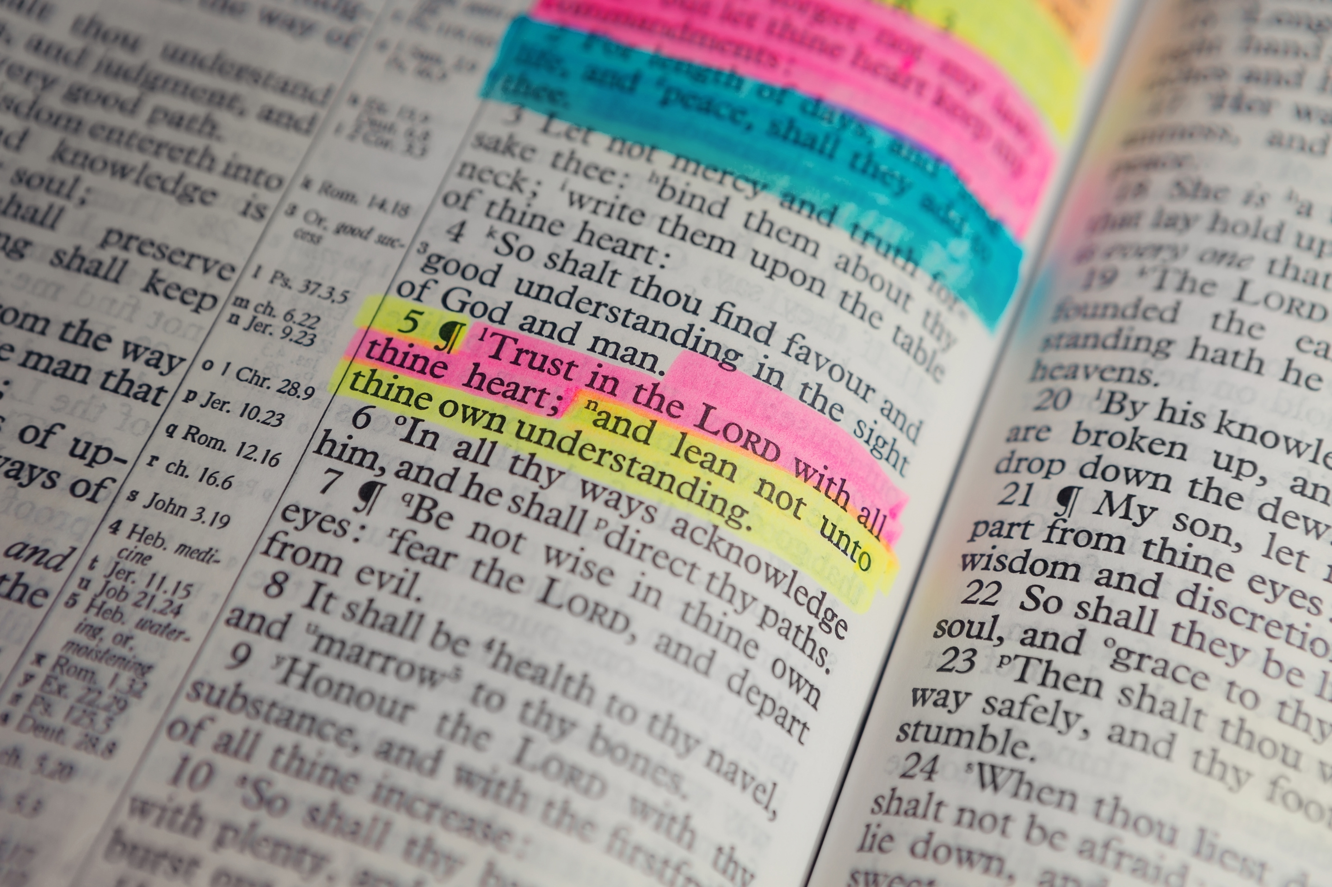
WE SHARED THE GOSPEL OVER
326
TIMES
CHANCES FOR THEM TO EXPERIENCE
ETERNAL LIFE IN CHRIST

Slide 6

HEALING TIDE OFFERED
HOPE & HEALING OVER
2,631
TIMES
TO THOSE GRIEVING PAST ABORTIONS
OR PREGNANCY & INFANT LOSS

Slide 7

WE PARTICIPATED IN
25
PROFESSIONS OF FAITH
OR REDEDICATIONS SO FAR

Slide 8
GOD IS NOT DONE IN THE PUGET SOUND, AND WE KNOW THIS WORK IS MORE IMPORTANT THAN EVER BEFORE.
IN THE NEW YEAR, CARE NET OF PUGET SOUND WILL CONTINUE TO PROVIDE COMPASSIONATE, CONFIDENTIAL CARE TO WOMEN AND FAMILIES THROUGH THE HOPE OF JESUS.
WE HOPE YOU'LL JOIN US.

